Slide 1
Load Testing -Jmeter

Slide 2
What is Non Functional Testing
Non functional testing is a type of software testing that verifies non functional aspects of the product, such as performance, stability, and usability. Whereas functional testing verifies whether or not the product does what it is supposed to, non functional testing verifies how well the product performs.
There are several different types of non functional tests. The most common ones are:
Performance Tests
Load Tests
Stress Tests
Volume Tests
Security Tests
Upgrade & Installation Tests
Recovery Tests

Slide 3
Load Testing
Load testing checks how the software behaves under both normal and peak conditions. This is done to determine how much work load the software can handle before performance is negatively affected.
You can perform load tests by running multiple applications simultaneously, subjecting a server to a high amount of traffic, or downloading a large quantity of files.
Load tests are used to ensure fast and scalable software.
This is typically done by:
Measuring response times
Identifying bottlenecks
Locating failure points

Slide 4
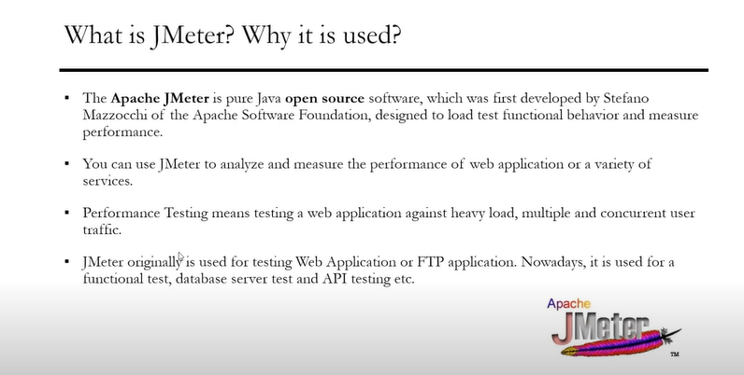
Jmeter and Advantages

Slide 5
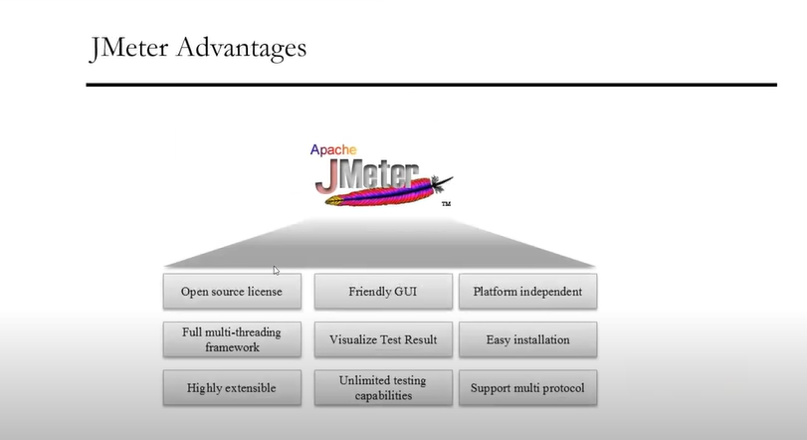
Benefits of Using Jmeter

Slide 6
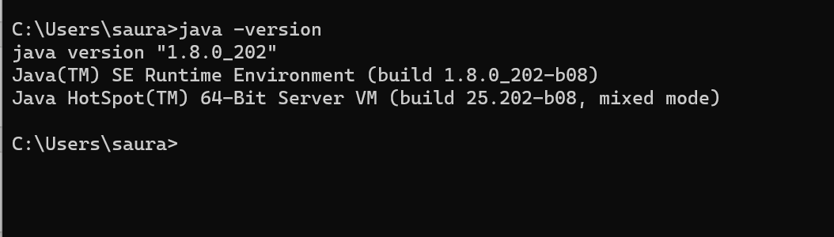
Jmeter Installation Prerequisite
Prerequisite
Java version 8 or above needs to be a part of the machine and environment variables needs to be set where Jmeter is getting installed .

Slide 7
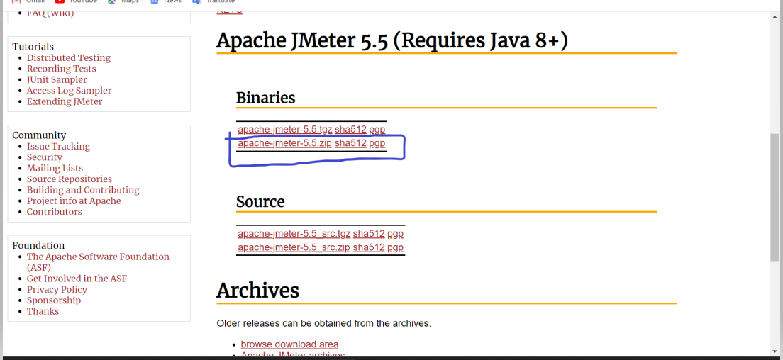
Steps of Installation
Open the URL ,
https://jmeter.apache.org/download_jmeter.cgi
And select the below option ,

Slide 8
Steps of Installation Continued

Slide 9
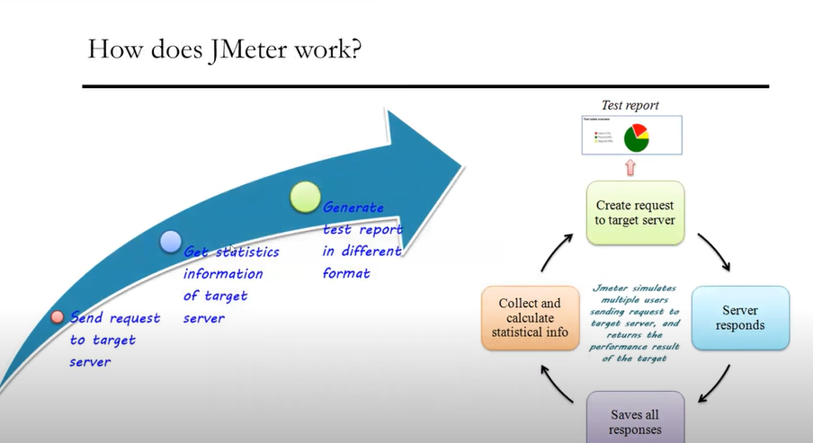
Working of Jmeter

Slide 10
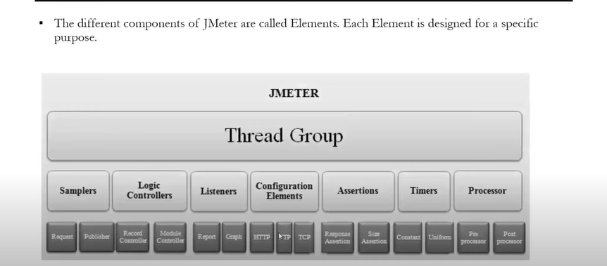
Components of Jmeter

Slide 11
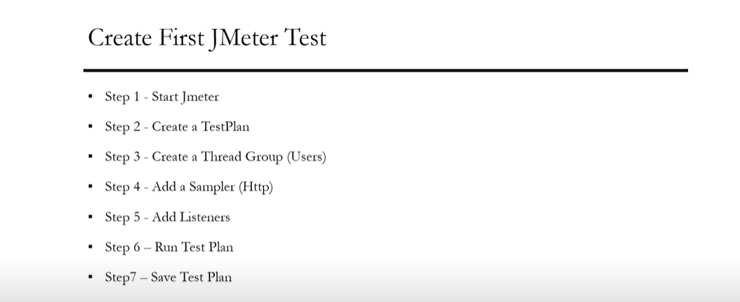
My First Jmeter Test

Slide 12
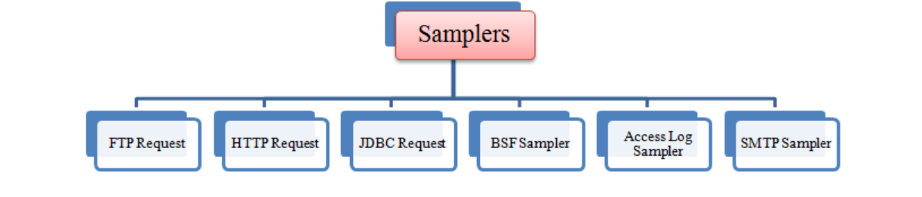
Samplers in Jmeter
The type of input which user is passing for a thread group is called as Samplers .
As we know already that JMeter supports testing HTTP, FTP, JDBC and many other protocols.
So based on these protocols the input is also passed into the thread group .

Slide 13
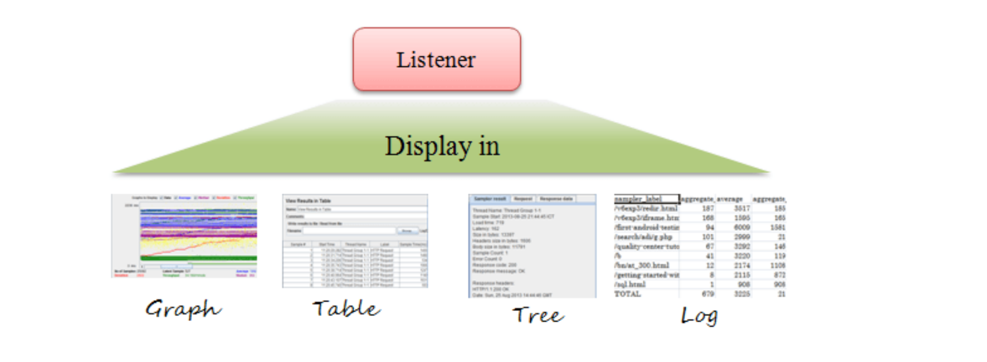
Listeners in Jmeter
Listeners: shows the results of the test execution. They can show results in a different format such as a tree, table, graph or log file.

Slide 14
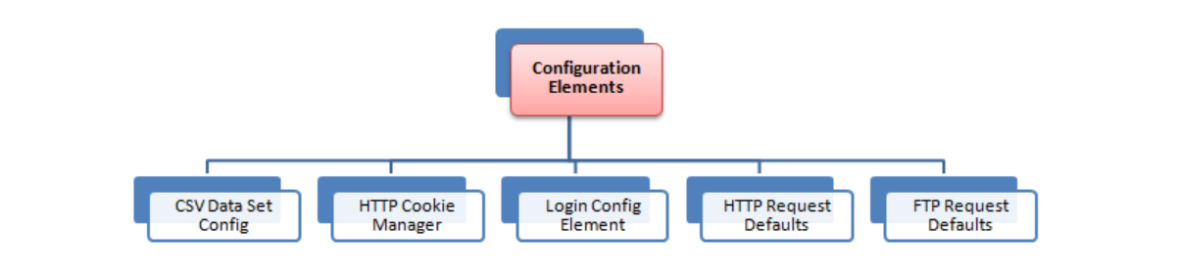
Configuration Elements
Configuration Element enable us to declare variables, so Samplers can use data through these variables. Configuration element is accessible from only inside the tree node where you defined it. Also, if a configuration element is defined inside a tree node, it will have high precedence than the same configuration element which is defined in a parent node
.

Slide 15
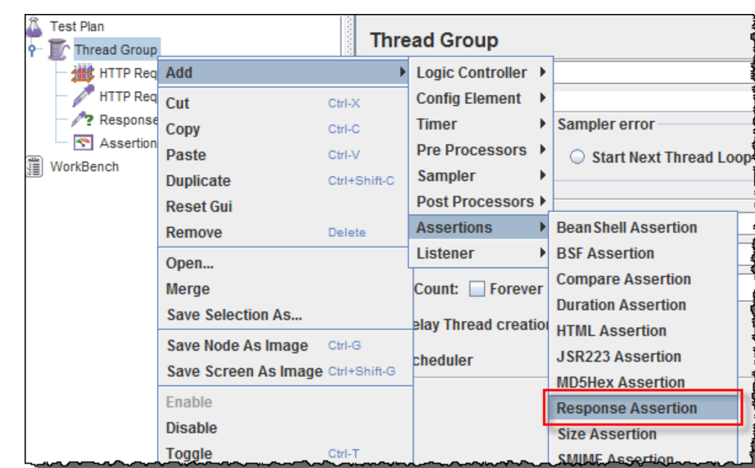
Assertions in Jmeter
Assertion help verifies that your server under test returns the expected results.
Following are some commonly used Assertion in JMeter:
Response Assertion
Duration Assertion
Size Assertion
XML Assertion
HTML Assertion
Steps to use Response Assertion

Slide 16
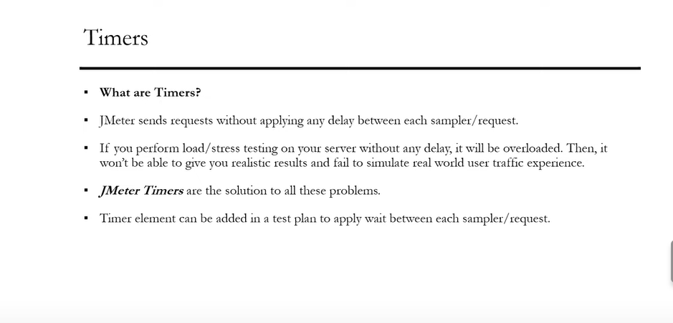
Jmeter Timers

Slide 17
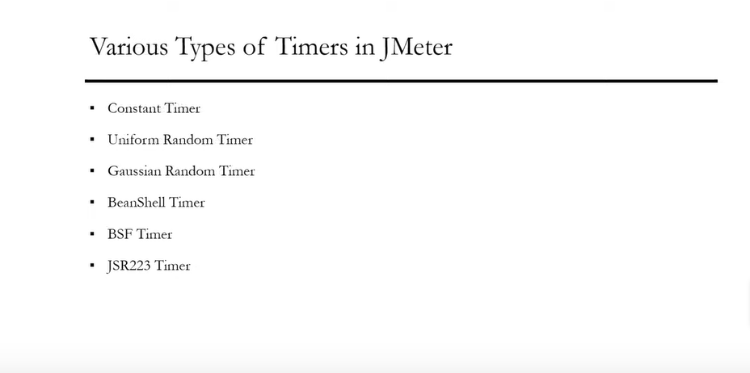
Types of Timers

Slide 18
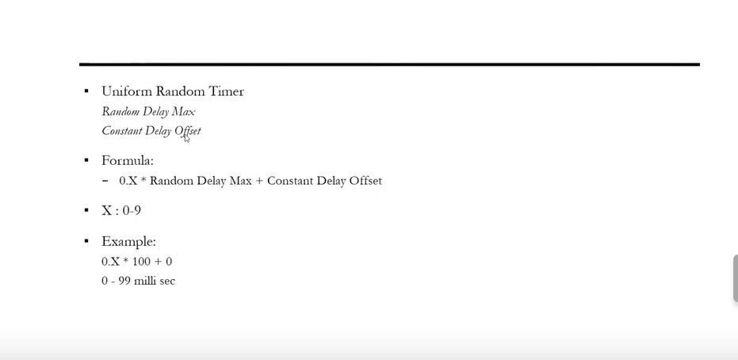
Uniform Random Timer Calculation

Slide 19
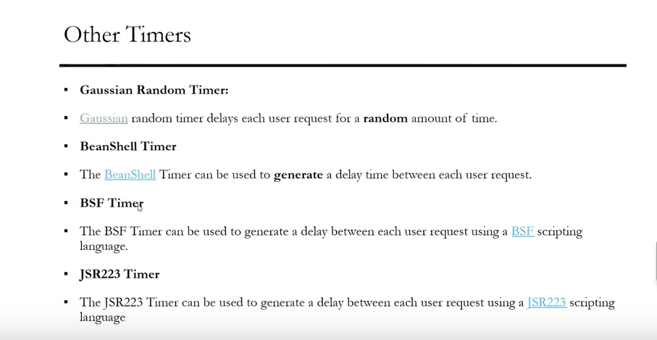
Other Timers(Not in Scope and Not used)

